Slide 1
Advanced Javascript
ES6

Slide 2
ECMAScript 6 was the second major revision to JavaScript.
ECMAScript 6 is also known as ES6 and ECMAScript 2015.
This chapter describes the most important features of ES6.

Slide 3
ES6 allows you to write the code in such a way that makes your code more modern and readable. By using ES6 features, we write less and do more, so the term 'Write less, do more' suits ES6.

Slide 4
let

Slide 5
The let keyword allows you to declare a variable with block scope.

Slide 6
const

Slide 7
The const keyword allows you to declare a constant (a JavaScript variable with a constant value).
Constants are similar to let variables, except that the value cannot be changed.

Slide 8
Arrow Functions
( ) =>

Slide 9
Another way of writing functions. So, what’s the difference?

Slide 10
Arrow functions are a simpler and more compact way of writing functions in JavaScript. Two factors influenced the introduction of arrow functions:
The need for shorter functions
Behavior of the this keyword.

Slide 11
double = (x) => {
return x*2
}
is the same as
function double(x){
return x*2
}

Slide 12
The new arrow functions also ensures that 'this' is handled better.

Slide 13
Arrow functions do not have their own this keyword property.

Slide 14
How do functions behave inside objects currently?

Slide 15
var myobj = {
i: 10,
b: () => console.log(this.i, this), //arrow function
c: function() {
console.log(this.i, this);
} //Normal function
}
myobj.b(); // prints undefined, Window {...} (or the global object)
myobj.c(); // prints 10, Object {...}

Slide 16
Arrow functions do not have their own this.
They are not well suited for defining object methods.
Arrow functions are not hoisted.
They must be defined before they are used.

Slide 17
for of

Slide 18
The JavaScript for/of statement loops through the values of an iterable objects.
for/of lets you loop over data structures that are iterable such as Arrays, Strings.

Slide 19
var txt = "JavaScript";
var x;
for (x of txt) {
console.log(x)
}
var cars = ["BMW", "Volvo", "Mini"];
var x;
for (x of cars) {
console.log(x)
}

Slide 20
ES6 allows you to write the code in such a way that makes your code more modern and readable.
By using ES6 features, we write less and do more, so the term 'Write less, do more' suits ES6.

Slide 21
Destructuring

Slide 22
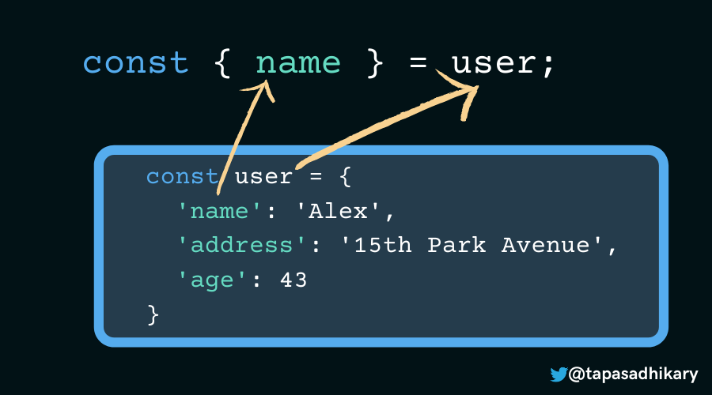

Slide 23
const user = {
'name': 'Alex',
'address': '15th Park Avenue',
'age': 43
}
const { name, age } = user;
console.log(name, age, salary); // Output, Alex 43 123455

Slide 24
const user = {
'name': 'Alex',
'address': '15th Park Avenue',
'age': 43
}
const { address: permanentAddress } = user;
console.log(permanentAddress); // 15th Park Avenue

Slide 25
const user = {
'name': 'Alex',
'address': '15th Park Avenue',
'age': 43,
'department':{
'name': 'Sales',
'Shift': 'Morning',
'address': {
'city': 'Bangalore',
'street': '7th Residency Rd',
'zip': 560001
}
}
}
const { department: { address } } = user;

Slide 26
const user = {
'name': 'Alex',
'address': '15th Park Avenue',
'age': 43
}
logDetails(user);
function logDetails({name, age}) {
console.log(`${name} is ${age} year(s) old!`)
}

Slide 27
spread

Slide 28
ES6 introduced a new operator referred to as a spread operator, which consists of three dots (...). It allows an iterable to expand in places where more than zero arguments are expected. It gives us the privilege to obtain the parameters from an array.

Slide 29
let colors = ['Red', 'Yellow'];
let newColors = [...colors, 'Violet', 'Orange', 'Green'];
console.log(newColors);

Slide 30
const user = {
'name': 'Alex',
'address': '15th Park Avenue',
'age': 43
}
const updatedUser = {...user, salary:12345};

Slide 31
Spread operator and Strings

Slide 32
Here, we have constructed an array str from individual strings.
let str = ['A', ...'EIO', 'U'];
console.log(str);

Slide 33
Rest

Slide 34
The rest parameter is introduced in ECMAScript 2015 or ES6, which improves the ability to handle parameters. The rest parameter allows us to represent an indefinite number of arguments as an array. By using the rest parameter, a function can be called with any number of arguments.

Slide 35
const user = {
'name': 'Alex',
'address': '15th Park Avenue',
'age': 43
}
const {age, ...rest} = user;
console.log(age, rest);

Slide 36
function show(...args) {
let sum = 0;
for (let i of args) {
sum += i;
}
console.log("Sum = "+sum);
}
show(10, 20, 30);

Slide 37
Rest parameter: collecting
Spread operator: expanding

Slide 38
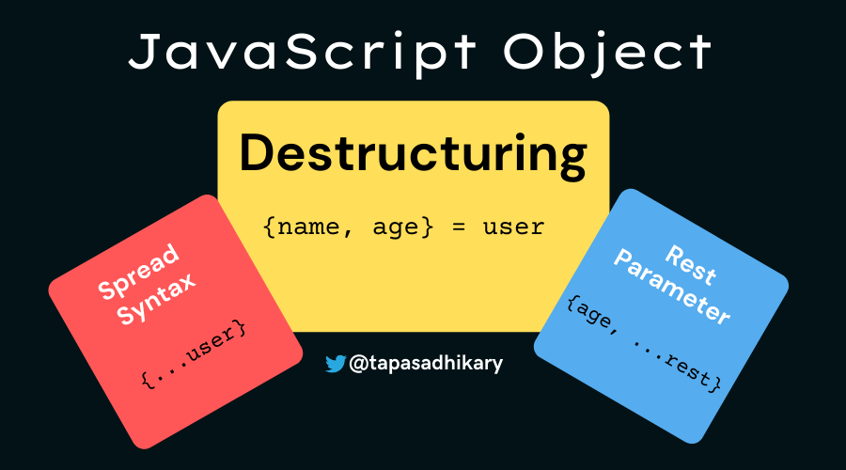

Slide 39
&&, II Operators

